Slide 1
XSL- EXtensible Stylesheet Language
Web Technology Lab

Slide 2
Introduction
The World Wide Web Consortium (W3C) started to develop XSL because there was a need for an XML-based Stylesheet Language.
XSLT is a language for transforming XML documents.
XPath is a language for navigating in XML documents.
XSL-FO - a language for formatting XML documents
XQuery is a language for querying XML documents.
XSLT is the most important part of XSL
XSLT transforms an XML document into another XML document
XSLT uses XPath to navigate in XML documents
XSLT is a W3C Recommendation

Slide 3
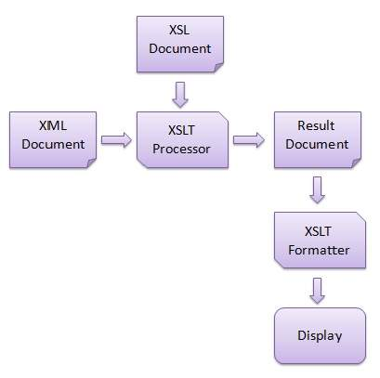
XSL Transformations
XSLT stylesheet is written in XML format.
XSLT Processor takes the XSLT stylesheet and applies the transformation rules on the target XML document
Then it generates a formatted document in the form of XML, HTML, or text format.
This formatted document is then utilized by XSLT formatter to generate the actual output which is to be displayed to the end-user.

Slide 4
students.xml
<?xml version = "1.0"?>
<class>
<student rollno = "393">
<firstname>Dinkar</firstname>
<lastname>Kad</lastname>
<nickname>Dinkar</nickname>
<marks>85</marks>
</student>
<student rollno = "493">
<firstname>Vaneet</firstname>
<lastname>Gupta</lastname>
<nickname>Vinni</nickname>
<marks>95</marks>
</student>
<student rollno = "593">
<firstname>Jasvir</firstname>
<lastname>Singh</lastname>
<nickname>Jazz</nickname>
<marks>90</marks>
</student>
</class>

Slide 5
students.xsl
<?xml version = "1.0" encoding = "UTF-8"?>
<!-- xsl stylesheet declaration with xsl namespace: Namespace tells the xlst processor about which element is to be processed and which is used for output purpose only -->
<xsl:stylesheet version = "1.0" xmlns:xsl = "http://www.w3.org/1999/XSL/Transform">
<!-- xsl template declaration: template tells the xlst processor about the section of xml
document which is to be formatted. It takes an XPath expression. In our case, it is matching document root element and will tell processor to process the entire document with this template. -->
<xsl:template match = "/">

Slide 6
Continued..
<!-- HTML tags Used for formatting purpose. Processor will skip them and browser will simply render them. -->
<html>
<body>
<h2>Students</h2>
<table border = "1">
<tr bgcolor = "#9acd32">
<th>Roll No</th>
<th>First Name</th>
<th>Last Name</th>
<th>Nick Name</th>
<th>Marks</th>
</tr>

Slide 7
Continued..
<!-- for-each processing instruction Looks for each element matching the XPath expression -->
<xsl:for-each select="class/student">
<tr>
<td>
<!-- value-of processing instruction process the value of the element matching the XPath expression -->
<xsl:value-of select = "@rollno"/>
</td>
<td><xsl:value-of select = "firstname"/></td>
<td><xsl:value-of select = "lastname"/></td>
<td><xsl:value-of select = "nickname"/></td>
<td><xsl:value-of select = "marks"/></td>
</tr>
</xsl:for-each>

Slide 8
End
</table>
</body>
</html>
</xsl:template>
</xsl:stylesheet>

Slide 9
Link the XSLT Document to the XML Document
Update student.xml document with the following xml-stylesheet tag
<?xml version = "1.0"?>
<?xml-stylesheet type = "text/xsl" href = "students.xsl"?>
<class>
...
</class>

Slide 10
Correct Stylesheet Declaration
The root element that declares the document to be an XSL style sheet is <xsl:stylesheet> or <xsl:transform>.
<xsl:stylesheet version="1.0" xmlns:xsl="http://www.w3.org/1999/XSL/Transform">
<xsl:transform version="1.0"
xmlns:xsl="http://www.w3.org/1999/XSL/Transform">
The xmlns:xsl="http://www.w3.org/1999/XSL/Transform" points to the official W3C XSLT namespace. If you use this namespace, you must also include the attribute version="1.0".
An XSL style sheet consists of one or more set of rules that are called templates.
A template contains rules to apply when a specified node is matched.
<xsl:template match="/">
The match attribute is used to associate a template with an XML element
The value of the match attribute is an XPath expression

Slide 11
<xsl:value-of> Element
The <xsl:value-of> element can be used to extract the value of an XML element and add it to the output stream of the transformation
<tr>
<td><xsl:value-of select="catalog/cd/title"/></td>
<td><xsl:value-of select="catalog/cd/artist"/></td>
</tr>
The select attribute, in the example above, contains an XPath expression. An XPath expression works like navigating a file system; a forward slash (/) selects subdirectories

Slide 12
<xsl:for-each> Element
The XSL <xsl:for-each> element can be used to select every XML element of a specified node-set:
<table border="1">
<tr bgcolor="#9acd32">
<th>Title</th>
<th>Artist</th>
</tr>
<xsl:for-each select="catalog/cd">
<tr>
<td><xsl:value-of select="title"/></td>
<td><xsl:value-of select="artist"/></td>
</tr>
</xsl:for-each>
</table>

